Slide 1
Grow Your Business
Social Media Management & Marketing Success

Slide 3
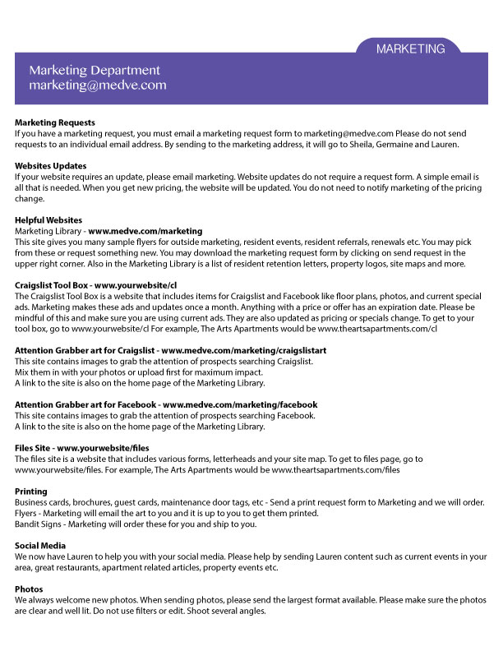

Slide 4
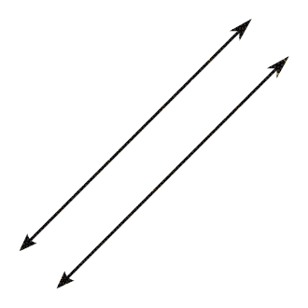
What works for you?
CONSISTENCY IS KEY
Where are you marketing?
What has been the most successful?

Slide 5
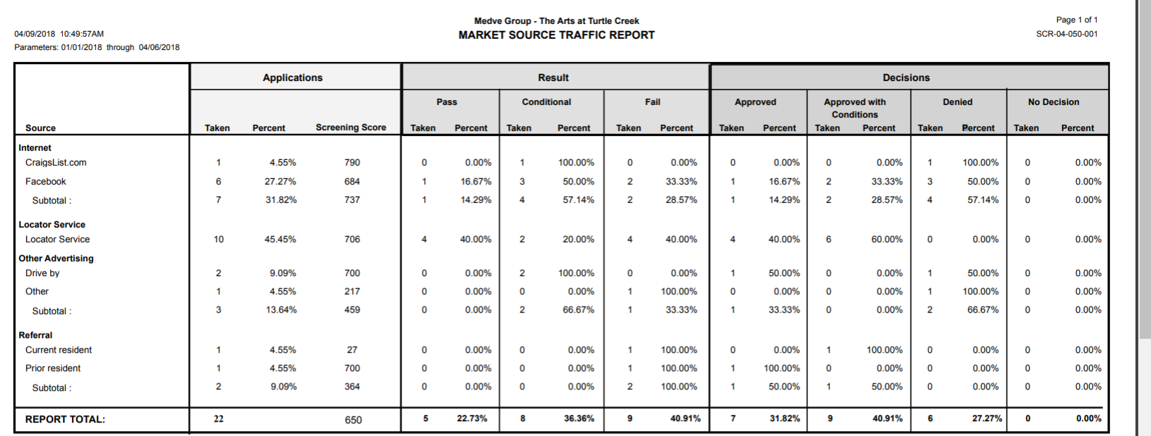
Helpful report for traffic source:

Slide 6
Do you know what your top 3 traffic sources were for 2017?
Because WE DO!

Slide 7
Quarter 1 results
Craigslist | Drive-By | Property Website | Res Ref | Locator | Rent.com/yelp | Apt guide /finder/forrent | Apartments.com | Facebook | Flyers / bandit sign | Google | preferred employer / sister properties | Other
108 | 57 | 3 | 53 | 23 | 2 | 19 | 15 | 66 | 0 | 27 | 14 | 27
24% | 13% | 1% | 12% | 5% | 0% | 4% | 3% | 14% | 0% | 6% | 3% | 6%
Top 3 sources:
CRAIGSLIST
FACEBOOK
DRIVE-BY
WHAT DOES THIS TELL YOU?

Slide 8
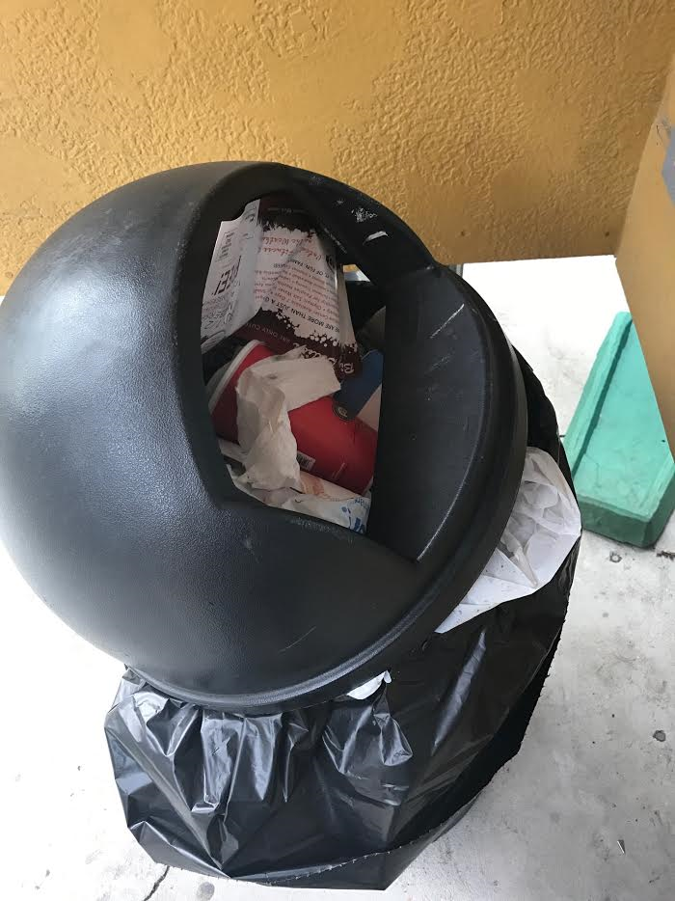
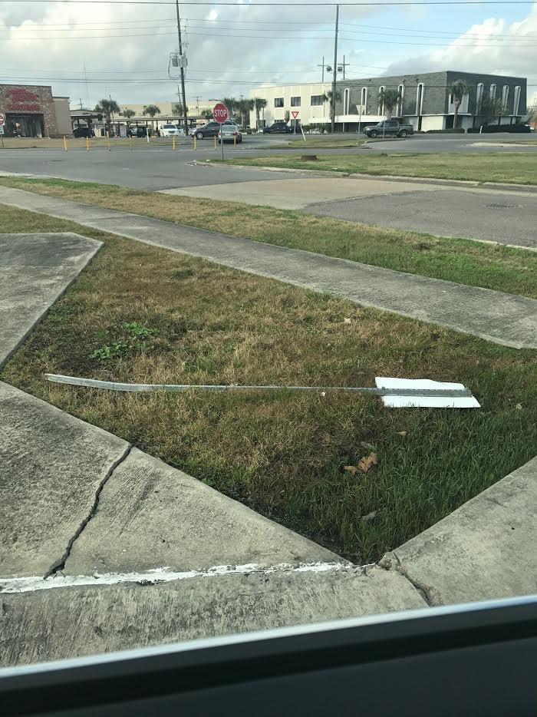
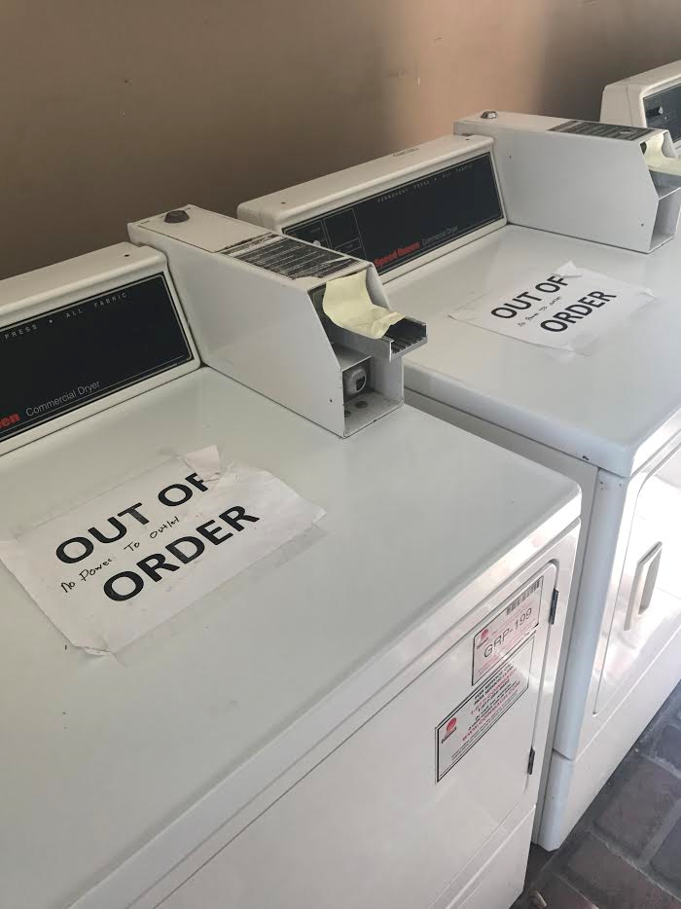
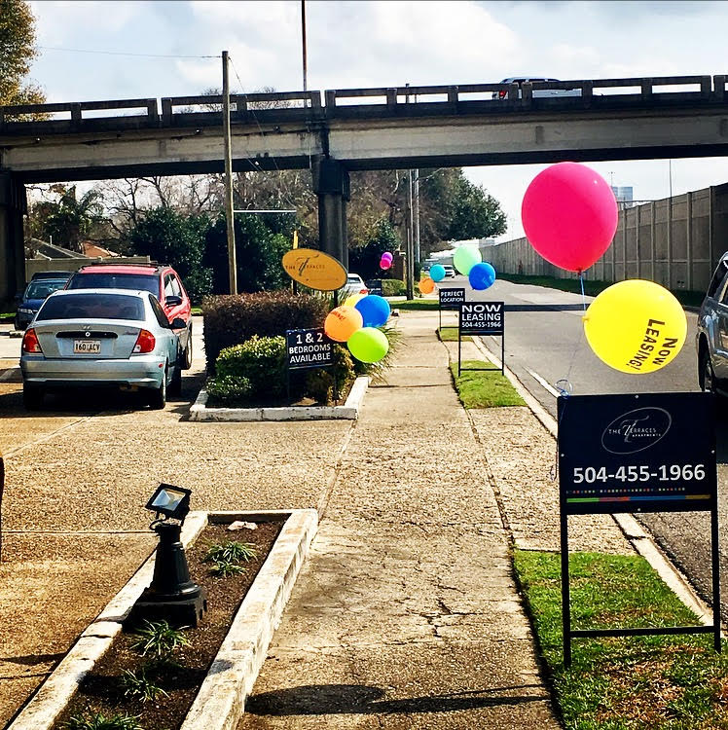
Is your platform ready?
When your property is presented well, it sends a message to both prospects and residents that they will be well taken care of after their move-in. When your property looks sloppy & unprepared: that’s the traffic you will see.

Slide 9
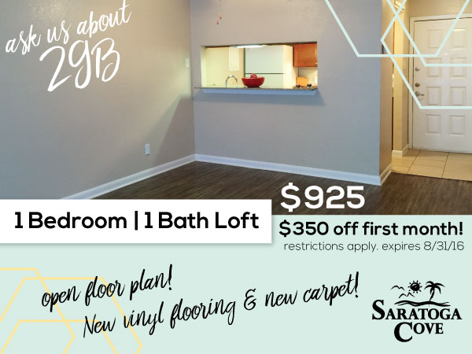
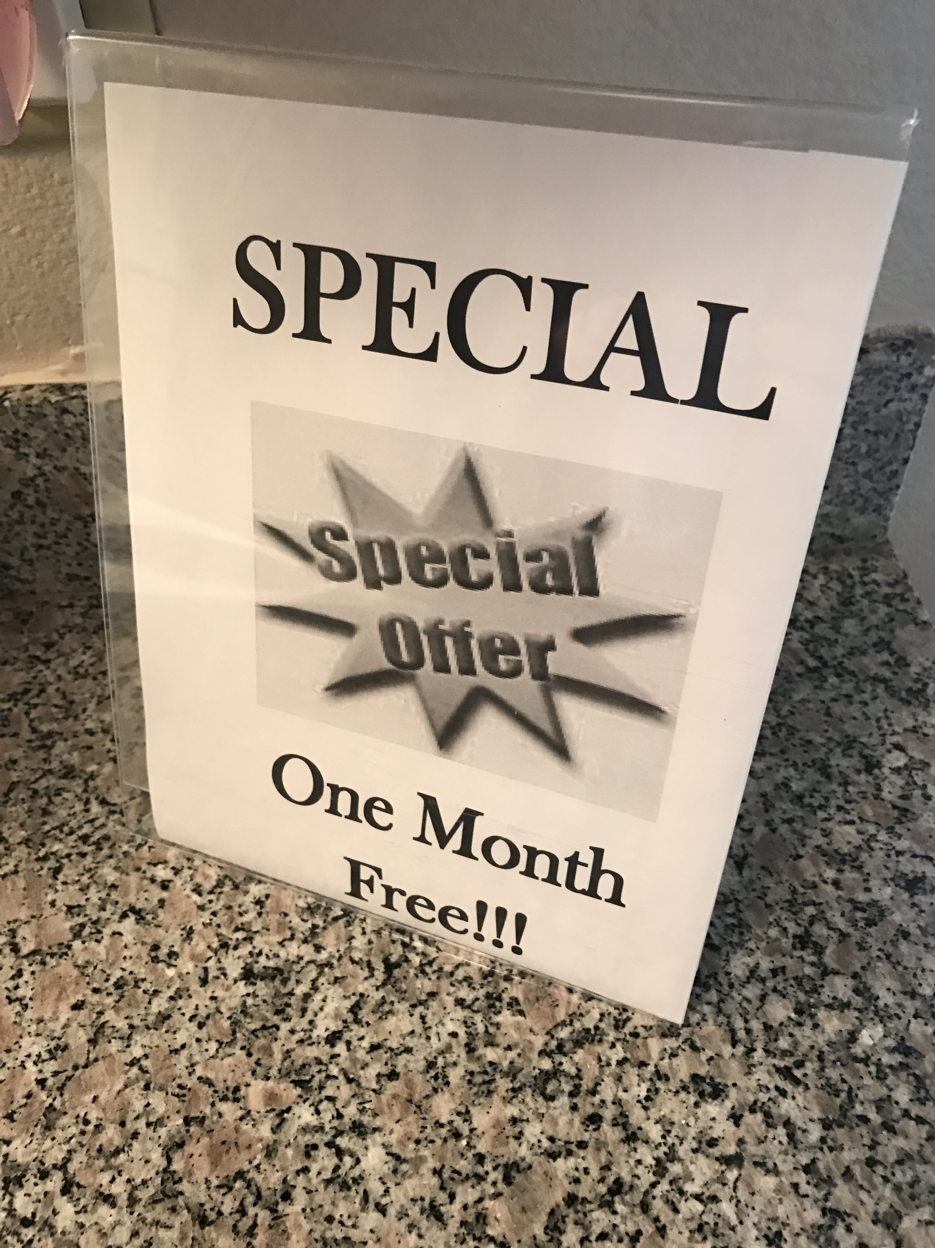
We have a marketing department for a reason…

Slide 10
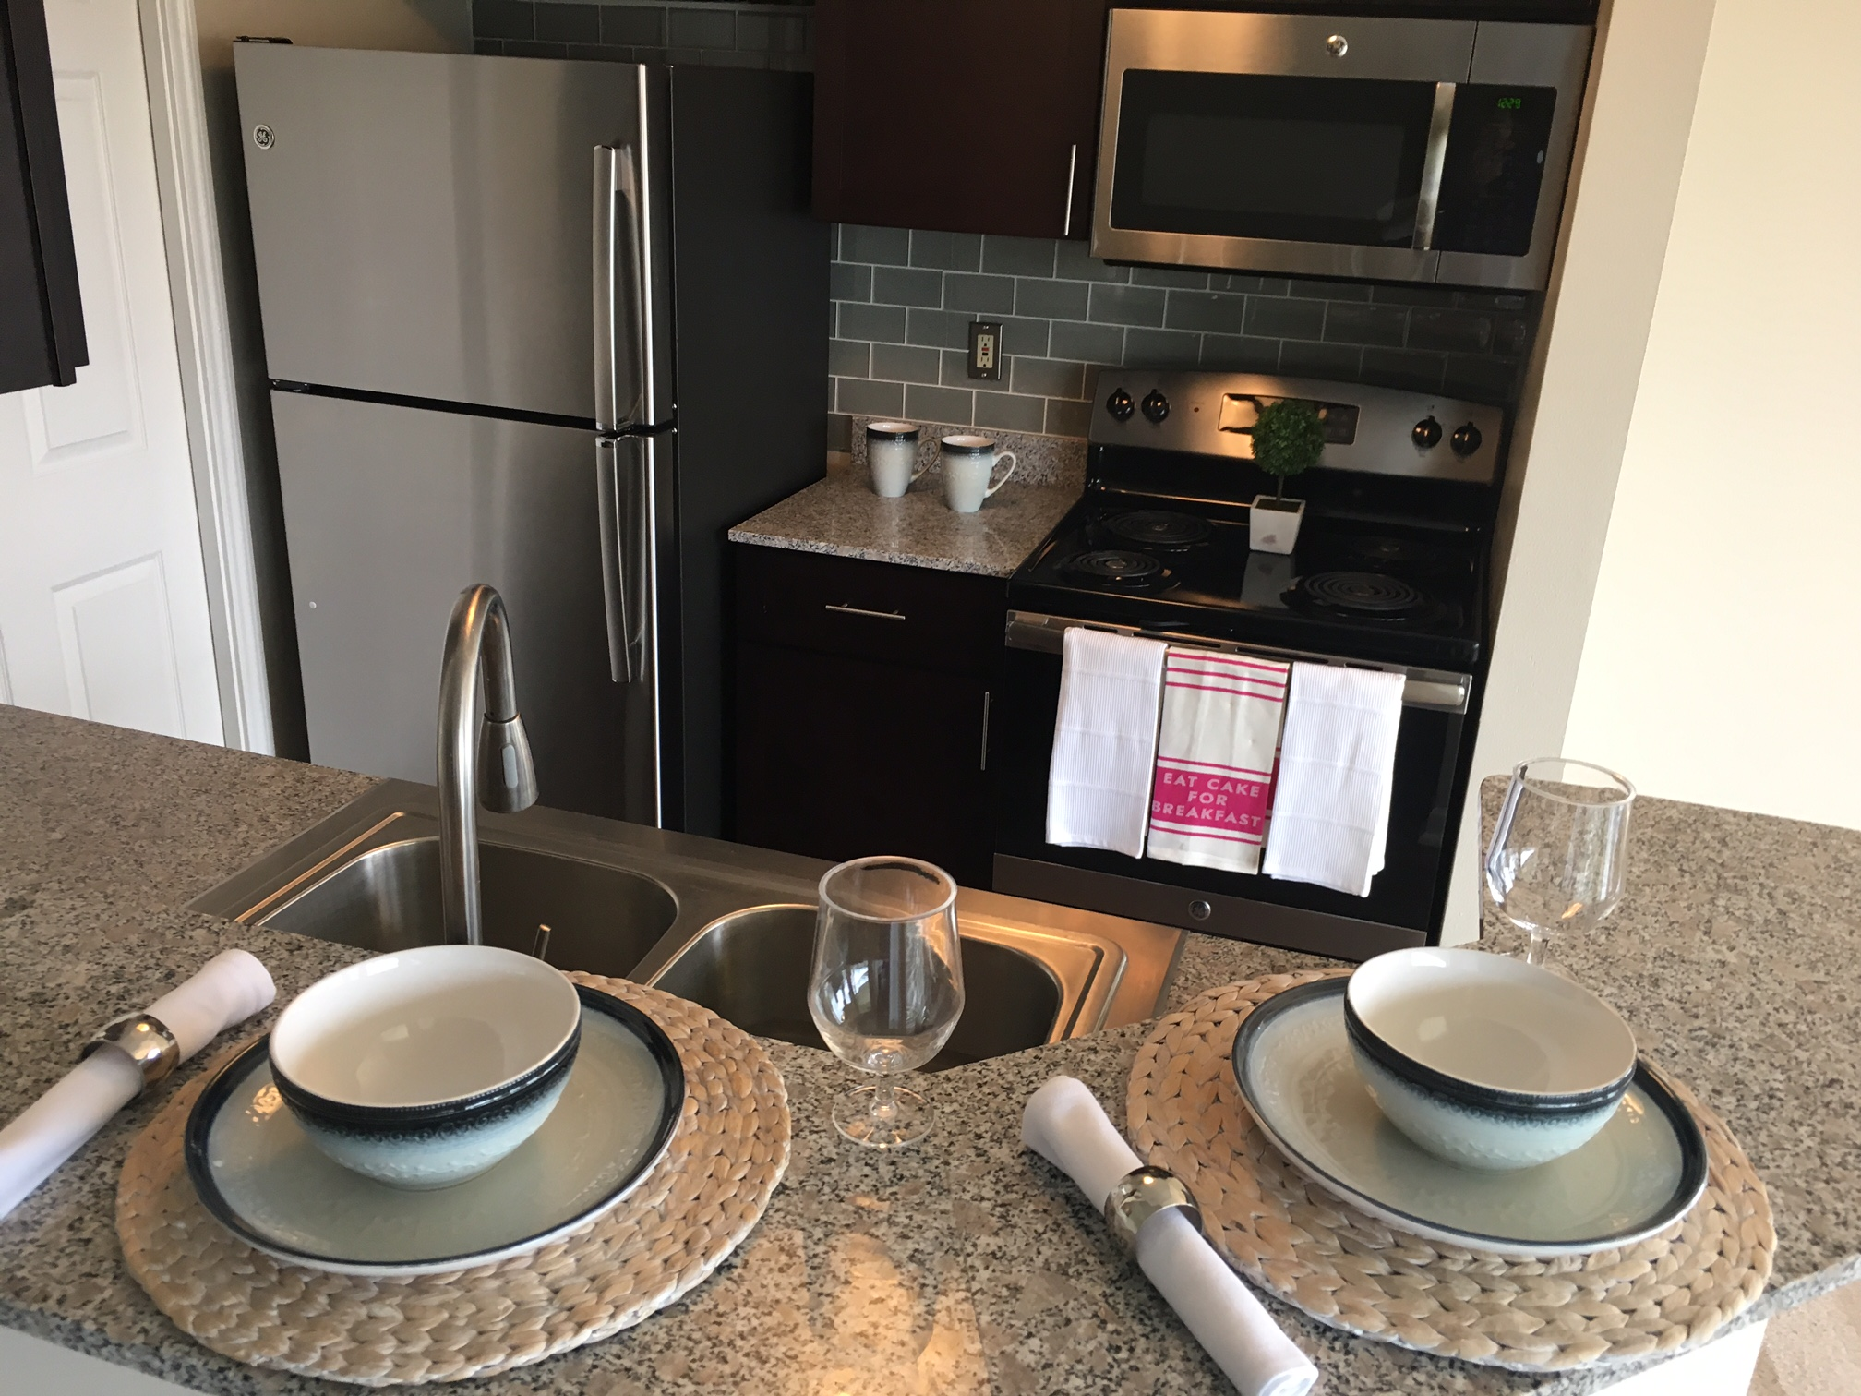
There is no excuse for not having a perfect unit to show. Show units should be well decorated, comfortable temperature, lights on, smells good, and welcoming.

Slide 11
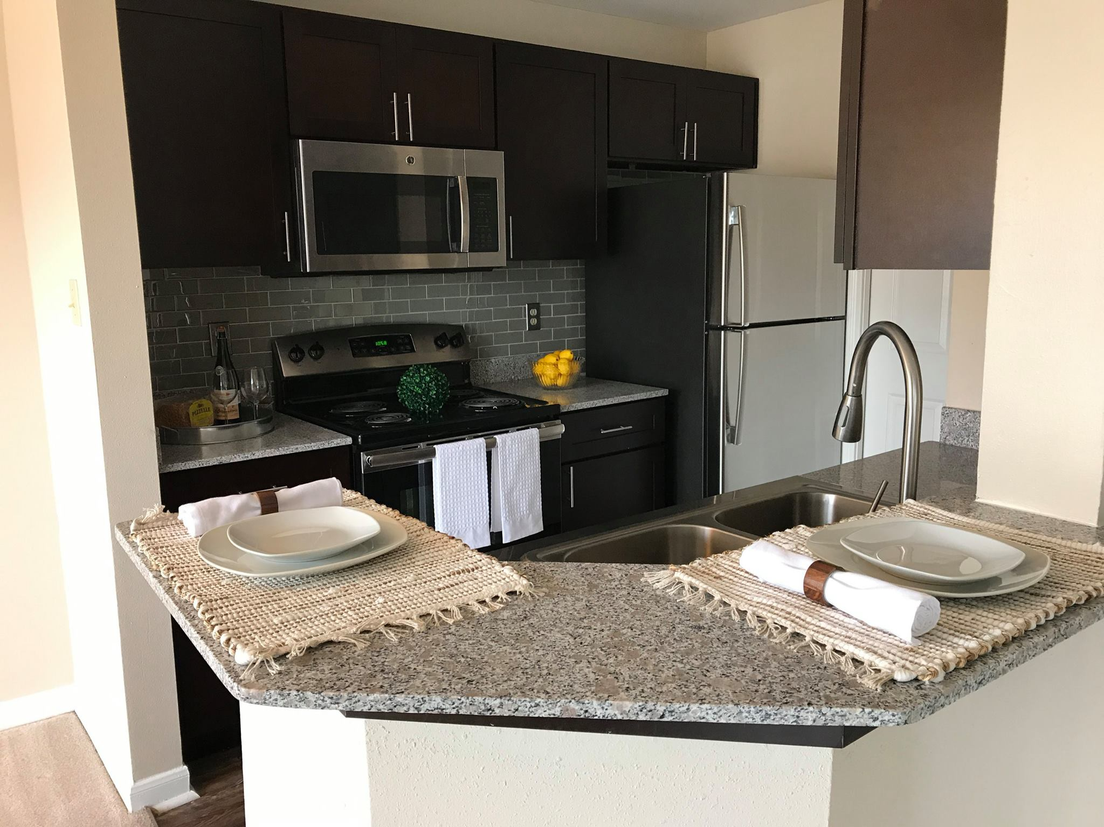
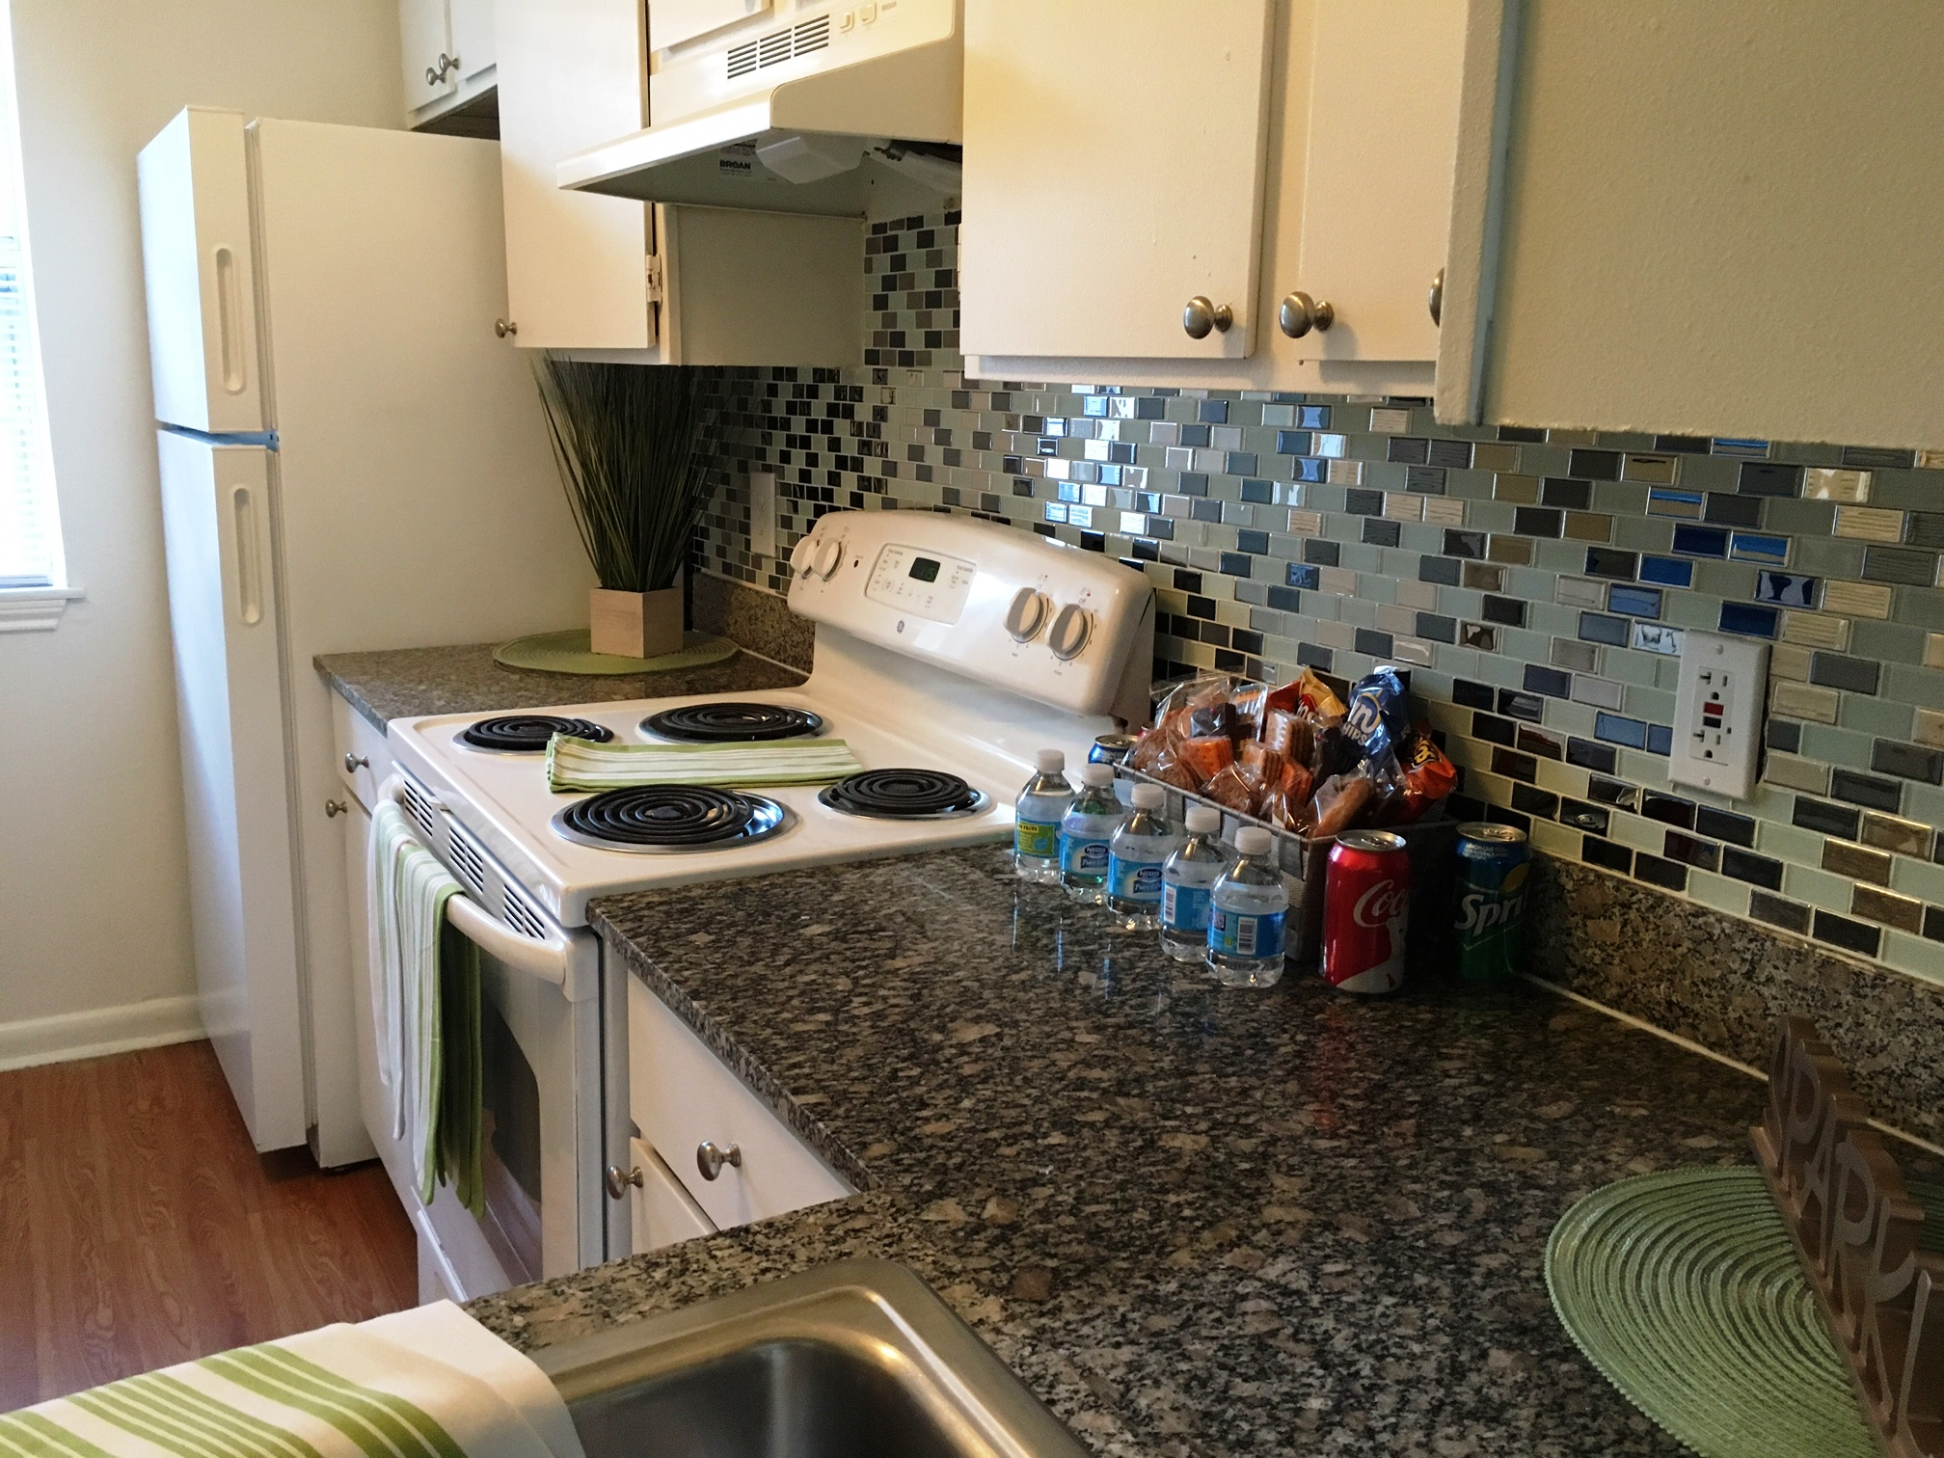
THE PRESENTATION: MOST IMPORTANT
Who wouldn’t want to live here?
Details separate us from our competitors.

Slide 12
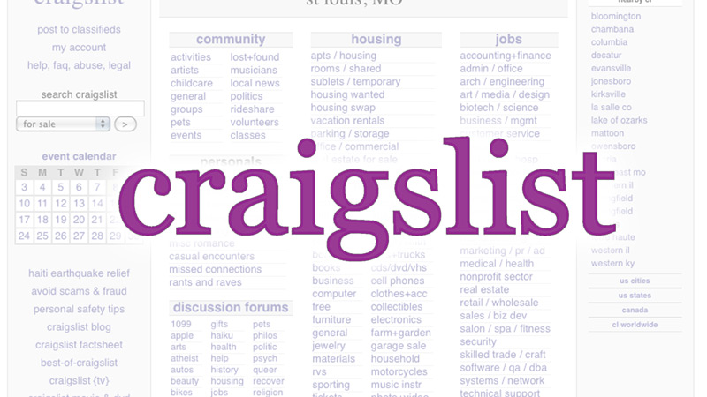
Craigslist Posts
Should be posting a minimum of 10 per day per person. If assistance is needed, please reach out.
Grammatically correct.
Accurate / up-to-date information!
Variety of photos and ads.
THIS IS A MUST

Slide 13
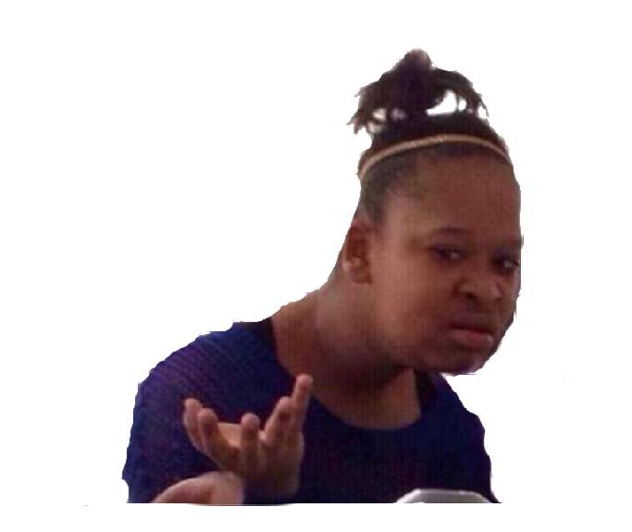
CRAIGSLIST NO NO:
“Monthly rent: $945....HOWEVER LEASE IN March AND REDUCE RENT TO $905!!” – posted 04/09/18
“One bedrooms starting at ONLY $665” – even with concession spread over 12 mo lease, the effective rent would be $720.
“______________________________” – many days there are NO ads posted for some properties.

Slide 14
Guess how many leases we received from Craigslist in 2017
672

Slide 16
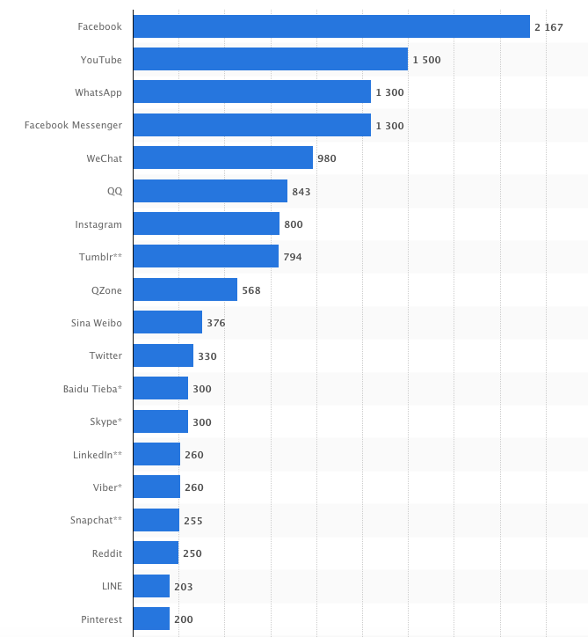
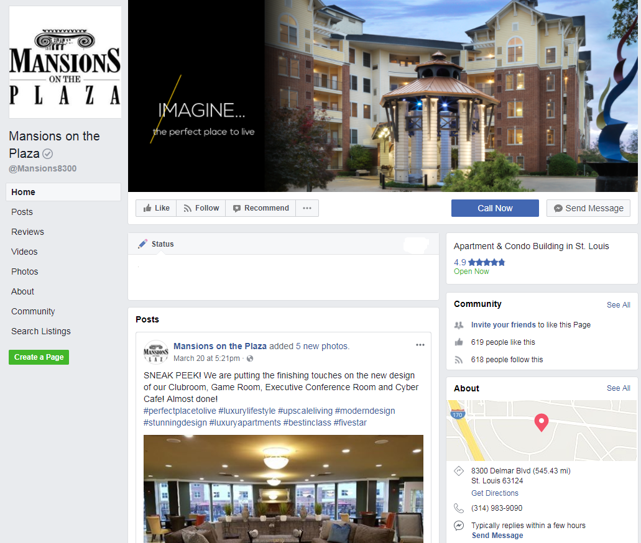
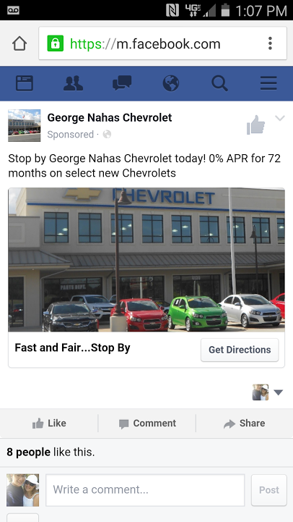
Most popular social networks worldwide
Notes:
This compilation of the most popular social networks worldwide prepared by Statista gives a clear picture of the number of active users (in millions) with Facebook ruling supreme. This won't be a shock to anyone! With over 2 billion active users it holds the majority market share. Google's YouTube is second with Facebook-owned, WhatsApp and Messenger not far behind.

Slide 17
FACEBOOK MARKETING
By now, the majority of you have a Facebook page. If you would like one, please let us know.
The Facebook page must be managed! Marketing, PMT, & Managers all monitor the pages. We have them “locked down” for the most part. We don’t want the ability to review the property or post on our Facebook walls. For those who do not have control of their page, you can still email pictures/suggestions to Lauren Mirhashemi, our social media assistant, at lmirhashemi@medve.com including our Marketing department.
Residents / prospects can and do comment on our posts. We like this! Generally, they are tagging friends or family that are looking to move or they are wanting to schedule an appointment.

Slide 18
THE SAME RULES APPLY:
Grammatically correct posts.
Ban users.
Delete comments.
Will be seen by more people and sooner than a Craigslist post.

Slide 19
Consumers Are on Facebook
Over 50% of U.S. consumers are on Facebook.
They spend an average of 40 minutes a day using it.
10
10
10
10
44% of users only access Facebook via a mobile device.
Source: Facebook
Notes:
You know how important search is for getting in front of users online.
Social, and particularly Facebook, has become the other half of the equation. This is where consumers of all age demographics are spending most of their time online - over any other site.

Slide 20
Businesses Are on Facebook, Too...
75% of businesses surveyed actively use Facebook to market their business.
40% believe social media advertising helps them gain new customers.
56% of businesses are investing in Facebook advertising this year. And 16% are spending more than they did in 2017.
Notes:
Facebook is not just for friends and socializing.
A majority of local businesses are creating a presence online, as well as investing in advertising to engage their potential consumers.
If you aren’t thinking about Facebook, you will start to lose out to local businesses that are.

Slide 21
Reaching new prospects

Slide 22
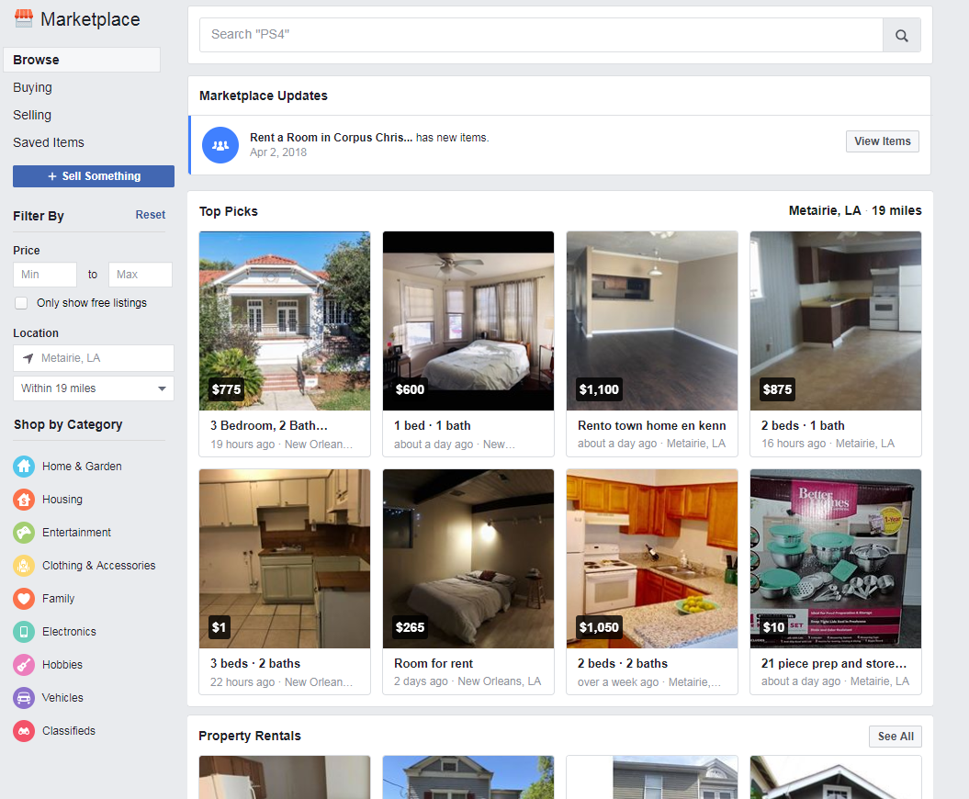
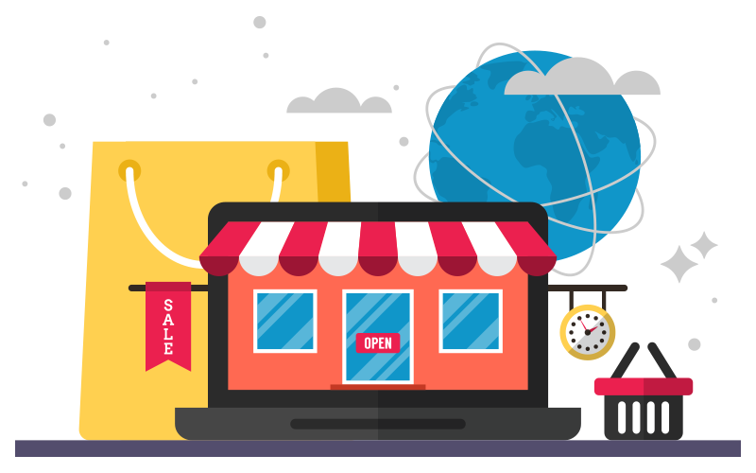
Marketplace
Under your “Home” page
On your left hand side, you will see “Marketplace” option
+Sell Something
All set!

Slide 23
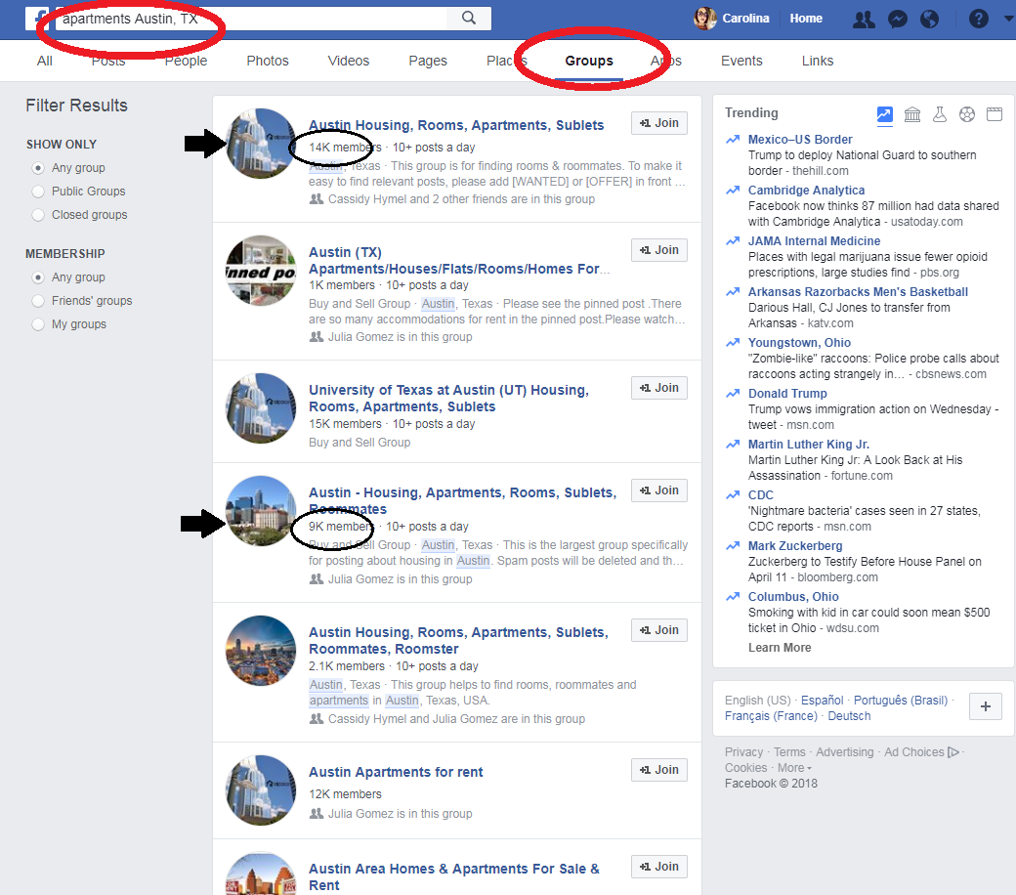
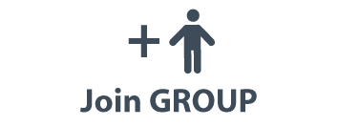
Join Groups
Suggestion words to search:
Apartments in CITY, STATE
Craigslist
For rent
Rentals
& much more

Slide 24
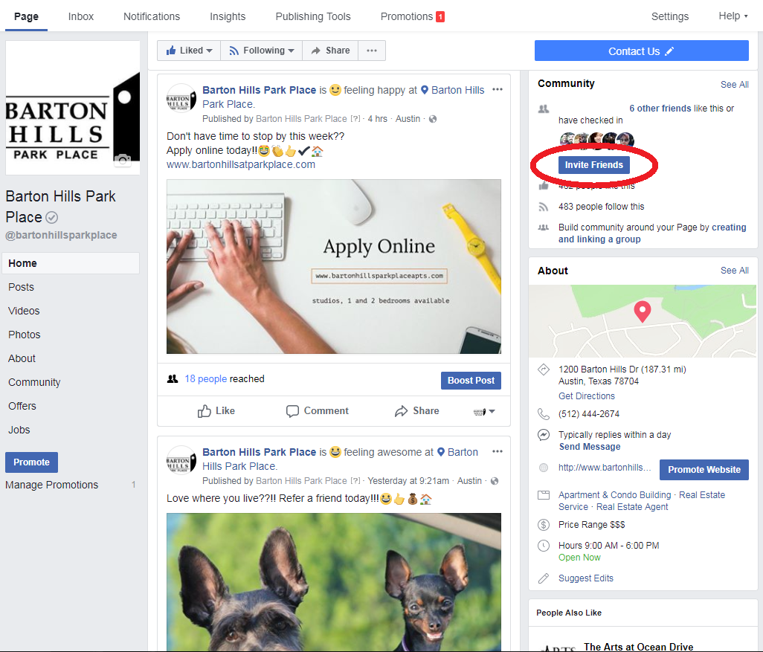
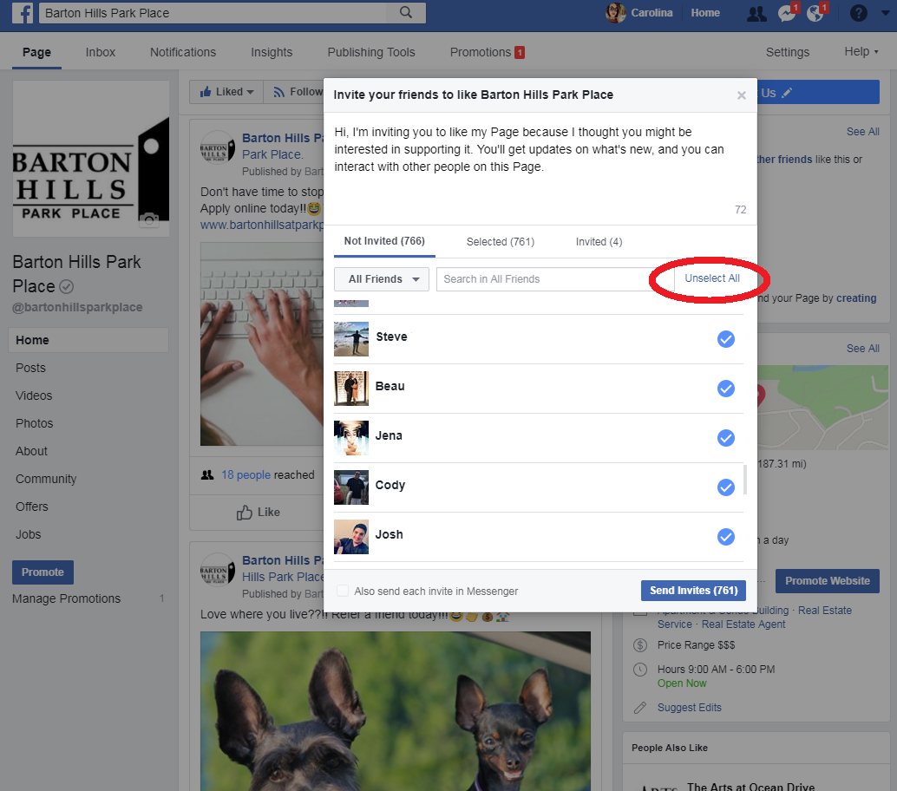
Invite Friends

Slide 25
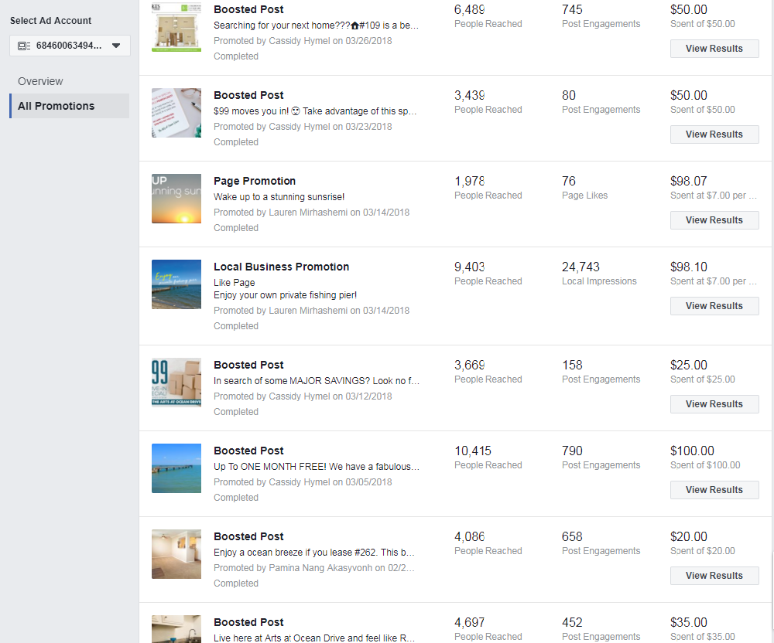
Boost Ads
Boosted ads give us results. There are many different ways to boost on a page. You may boost ads posted, videos, page, send msg button, like page button, etc.
This can only be done by a member of PMT or the marketing department.
If there is anything you would like to be boosted, reach out to us.

Slide 26
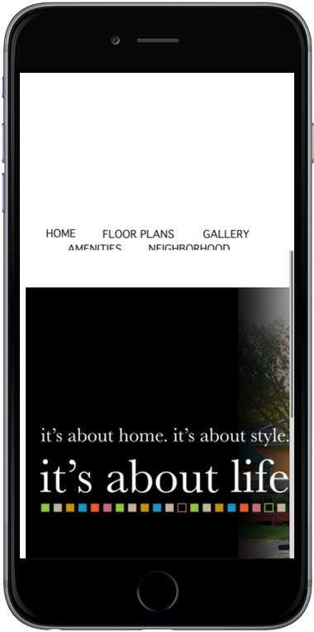
Social Media Tips
Post 2-3 times a week; only post more than that if you have to communicate a message
Publish new content
Be picky about what you share. Quality beats quantity.
Photos & videos have shown to be the most popular type of social media content for engagement
Measure your efforts & analyze the results
Join in on communities- partner with local businesses on Facebook to promote
Interact on a regular basis with users
Use keywords in your posts and capitalize on Hashtags
Target your social media posts. You can edit your audience & reach out to a bigger market.
Get creative! Keep your audience entertained. Do a contest, poll, post a picture that requires an answer/experience, etc.
Notes:
Unlike any other type of online advertising, Facebook has unique types of programs - driving phone calls, local store traffic, engagement on your Facebook page, video views, as well as traffic to your website

Slide 27
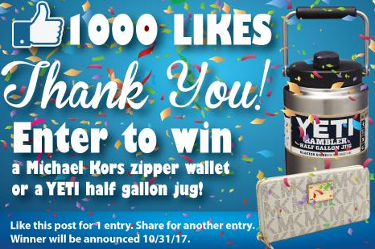
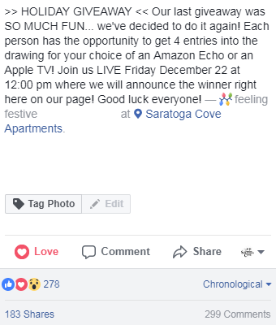
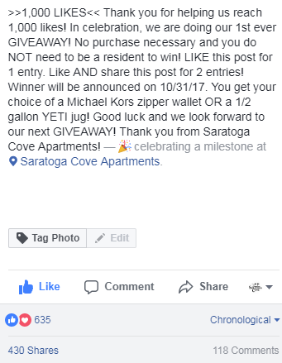
GIVEAWAY FUN
Over 430 Shares; 635 Reactions; 299 Comments

Slide 28
PARTNERING WITH LOCAL BUSINESSES

Slide 29
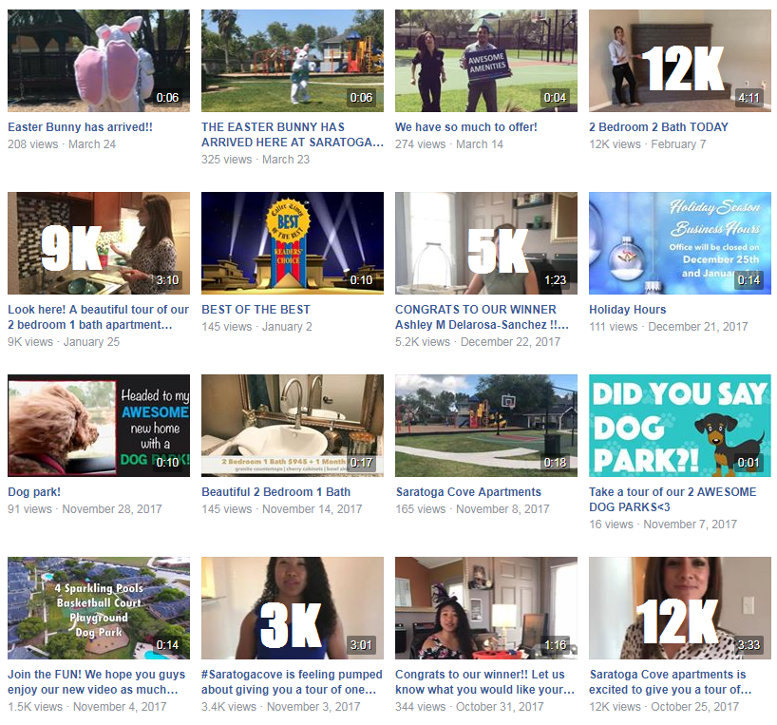
Over 43K view in the last 6 months

Slide 30
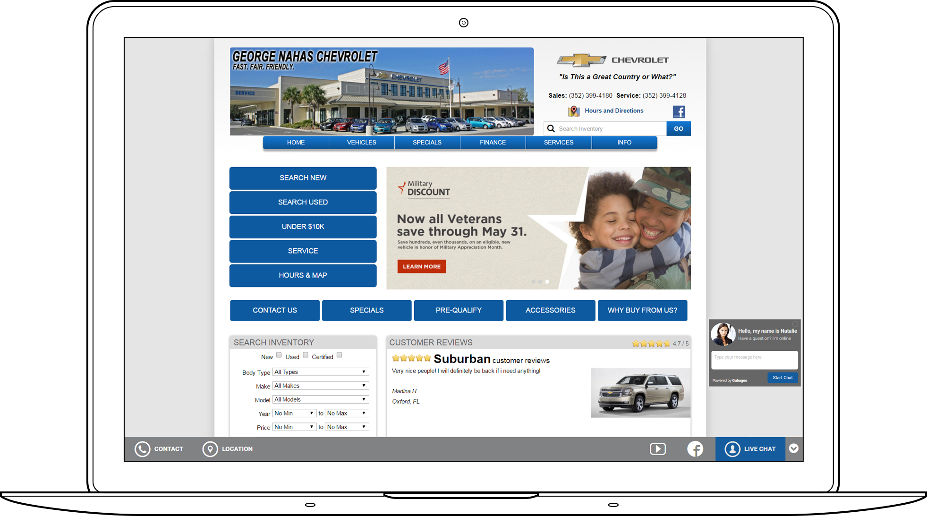
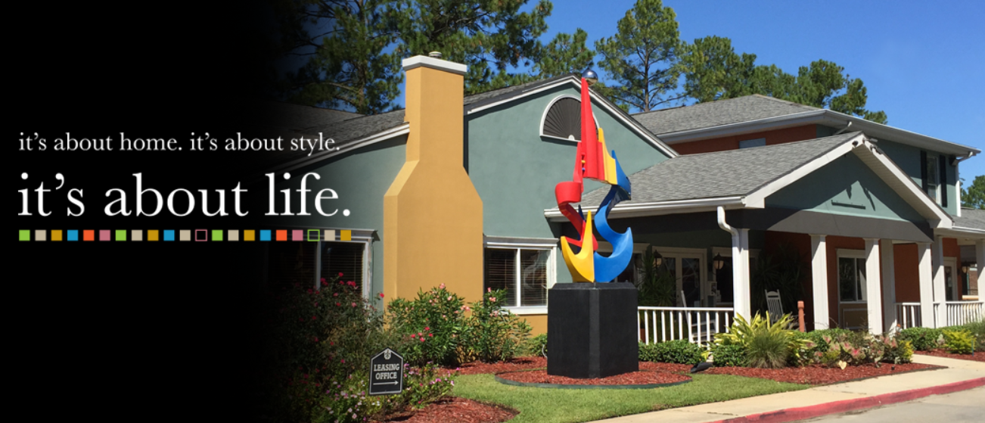
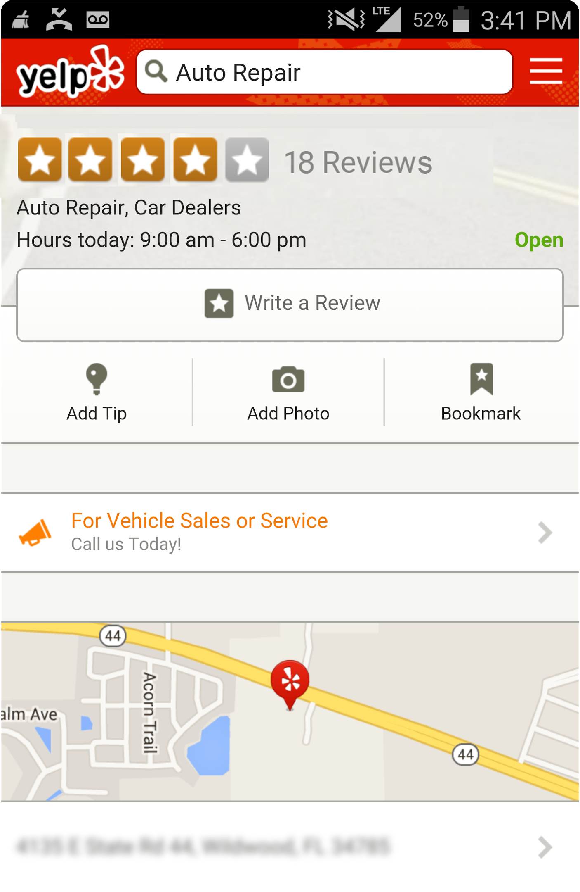
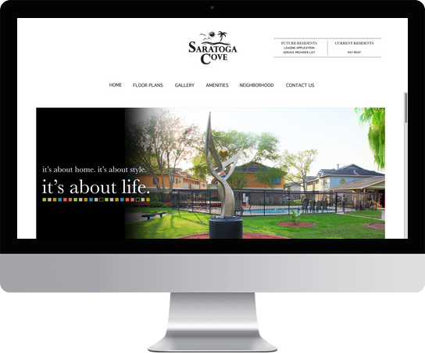
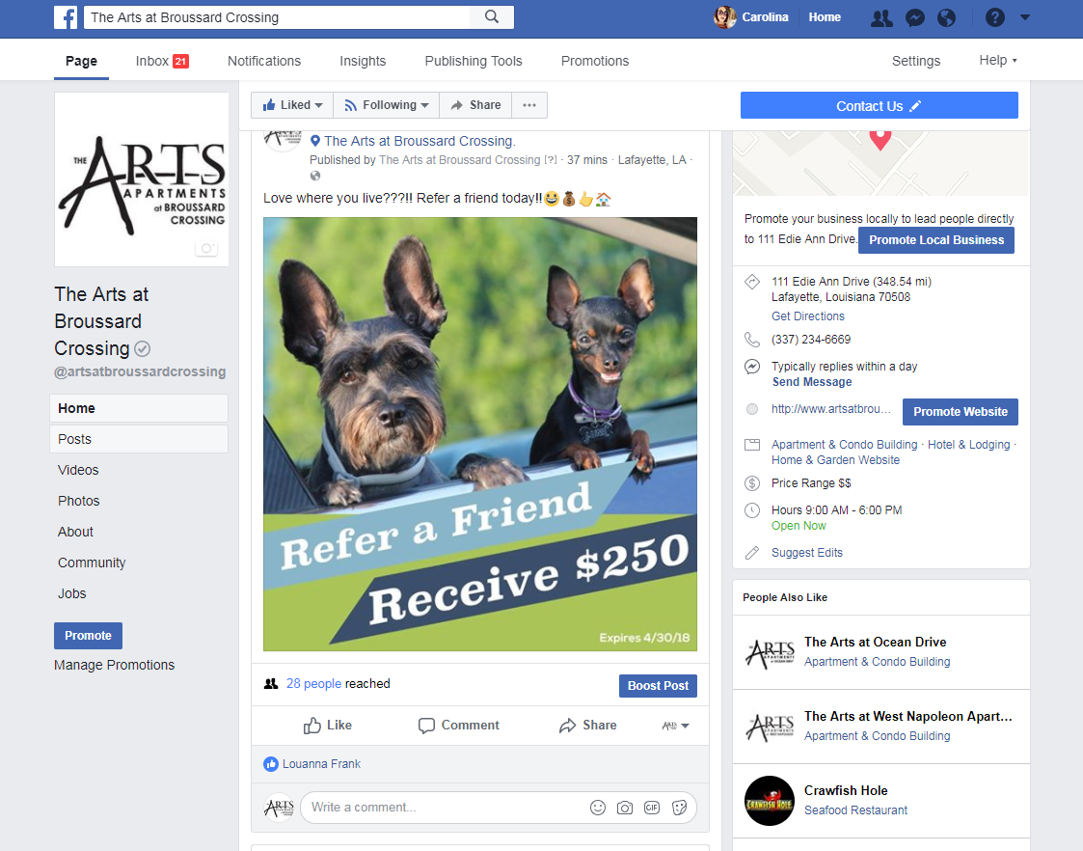
It’s Important to the Buying Process
Site Visit
Search on a Search Engine
Reviews on Yelp
and /or Facebook
Targeted Awareness
On Facebook
Facebook Retargeting
Based on Site Visit
Call or In-Person Visit
Leading to Purchase
Promote!
Social, search, local directories, and your website are key to the consumer buying process.
Notes:
Its not one single online experience that drives a consumer to a decision and a transaction.
It is a series of “micro-moments” that influence the awareness, interest, consideration and purchase decision (specifically on mobile).
By building a presence online, you start to build a presence in these micro moments and impact interest and intent.

Slide 31
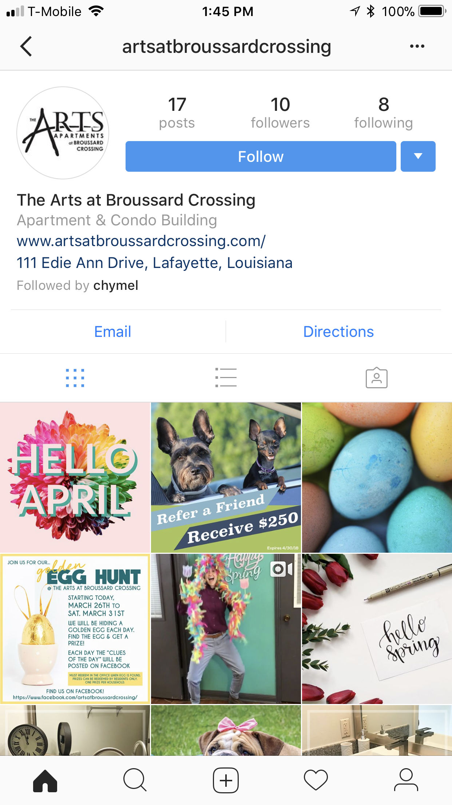
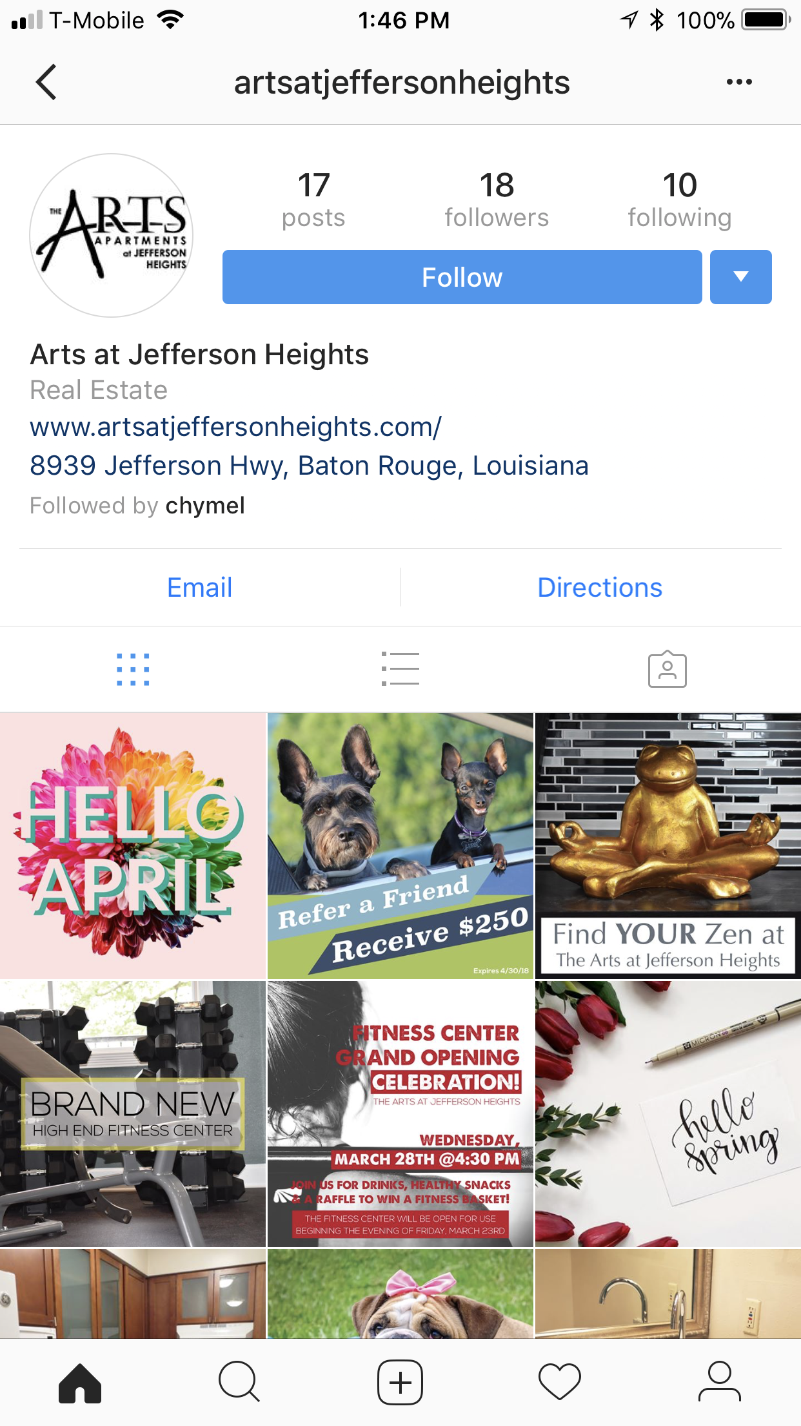
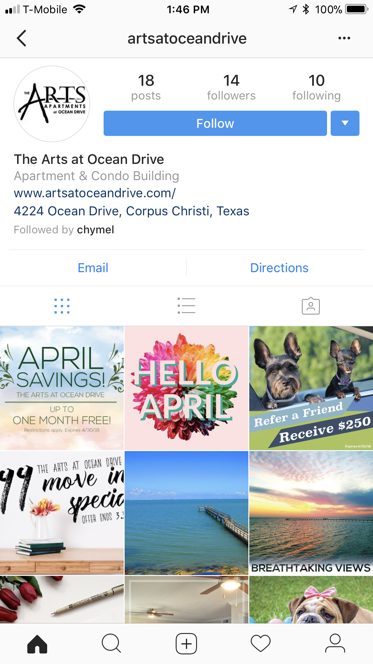
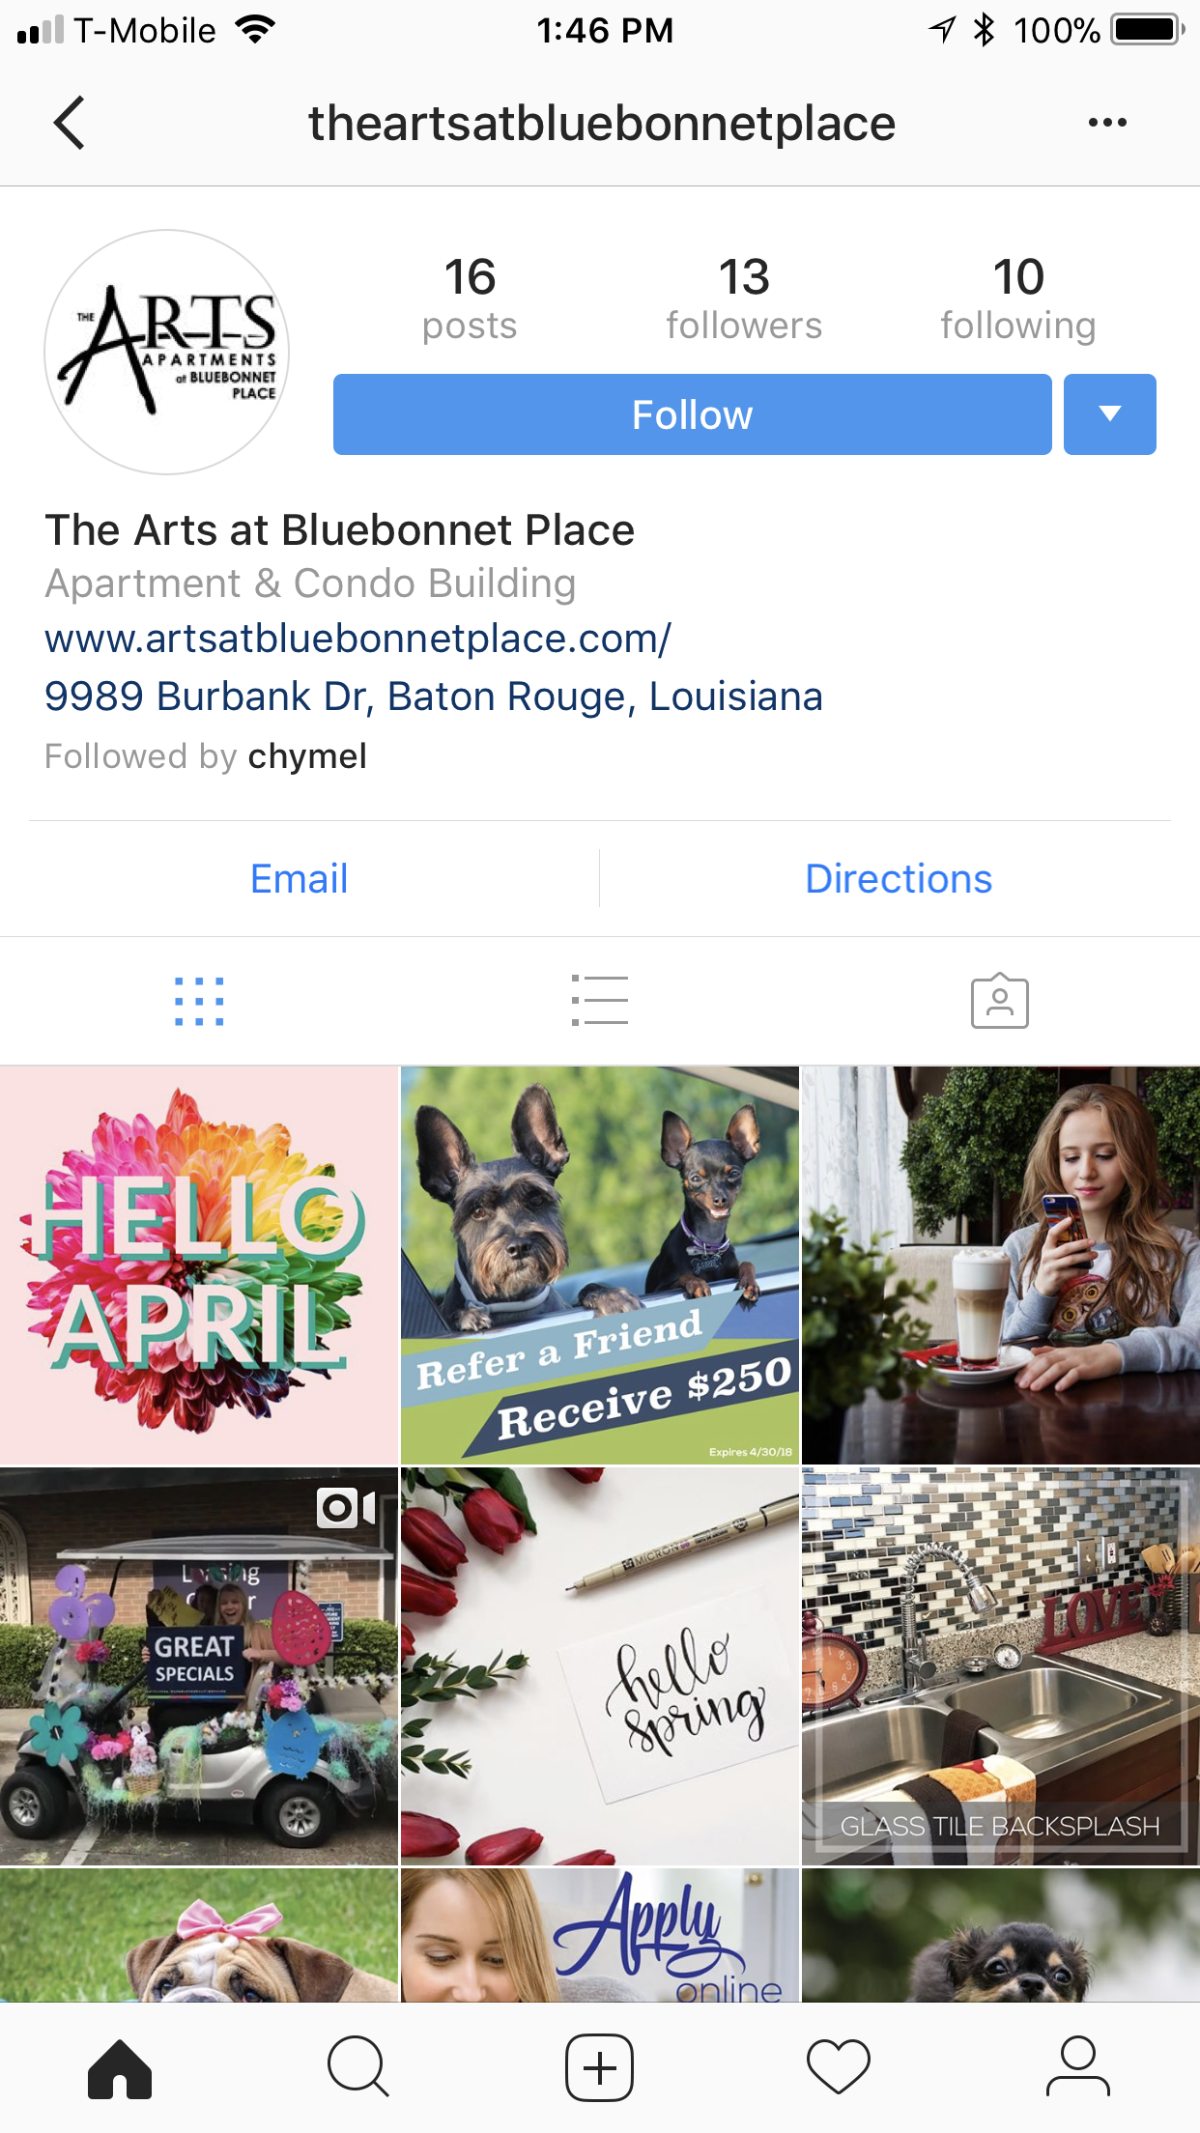
Send pictures, vids, boomerangs to the marketing department to keep your page updated with the most recent material. Marketing is the only department in control.

Slide 32
You are provided with all tools and assistance needed to be successful.
You will only be as successful as your weakest link.
We can teach you the Medve way, but we can not teach you how to be successful. There’s an “it factor” and you either have it or you don’t.
Would you live at your property? If the answer is no, go back to your property, look around, and turn that “no” into a “YES!”.
Lets have an AWESOME 2018!

